Slide 1
Ad_hoc Insights
Consumer Goods
Created by :Prachi Jadhav

Slide 2
OBJECTIVES
Tony Sharma Atliq Hardware is one of the major computer hardware manufacturers in India, with a strong presence in other nations.
Nevertheless, the management did note that they do not have sufficient insights to make prompt, wise, and data-informed judgments.
Plan to expand the data analytics team by adding junior data analysts.
To assess candidates, Data analytics director, Tony Sharma plans to conduct a SQL challenge to evaluate both tech and soft skills.
The company seeks insights for 10 ad hoc requests

Slide 3
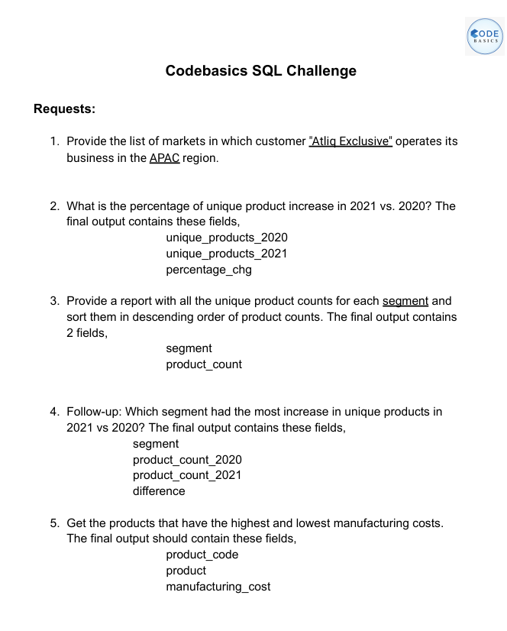
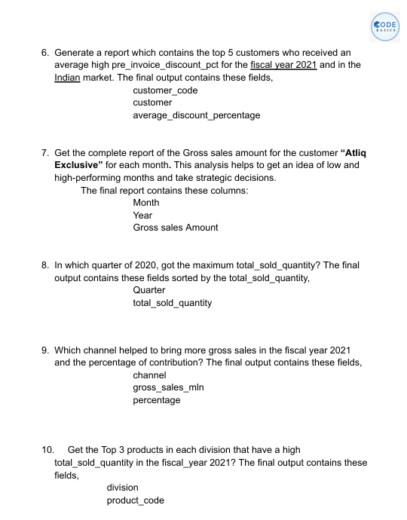
Data, Requests, and Tools
🔹 Database Schema Summary
Dimension Tables:
dim_customer: Customer info (code, name, market, channel)
dim_product: Product info (code, name, category, segment)
dim_date: Time details (date, month, quarter, year)
Fact Tables:
fact_sales_monthly: Sales quantity & revenue
fact_manufacturing_cost: Product cost per year
fact_gross_price: Gross price by fiscal year
fact_pre_invoice_deductions: Discounts before invoice
fact_post_invoice_deductions: Discounts after invoice
fact_freight_cost: Shipping cost per product/customer
fact_forecast_monthly: Forecasted quantity & revenue
🔗 Keys: Linked using product_code, customer_code, and date for analysis.
Tool : MySQL

Slide 4
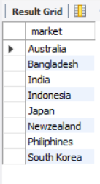
1. PROVIDE THE LIST OF MARKETS IN WHICH CUSTOMER "ATLIQ EXCLUSIVE" OPERATES ITS BUSINESS IN THE APAC REGION
SELECT market FROM dim_customer
WHERE customer = 'Atliq Exclusive' AND region = 'APAC’
GROUP BY market
ORDER BY market ;

Slide 5

2. WHAT IS THE PERCENTAGE OF UNIQUE PRODUCT INCREASE IN 2021 VS. 2020? THE FINAL OUTPUT CONTAINS THESE FIELDS, UNIQUE_PRODUCTS_2020 UNIQUE_PRODUCTS_2021 PERCENTAGE_CHG
SELECT X.A AS unique_product_2020,
Y.B AS unique_products_2021,
ROUND((B-A)*100/A, 2) AS percentage_chg
FROM (
(SELECT COUNT(DISTINCT(product_code)) AS A FROM fact_sales_monthly
WHERE fiscal_year = 2020) X,
(SELECT COUNT(DISTINCT(product_code)) AS B FROM fact_sales_monthly
WHERE fiscal_year = 2021) Y
)
Insight: Demand and production both
Increased.

Slide 6
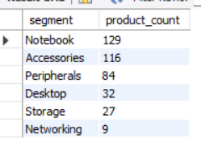
3. Provide a report with all the unique product counts for each segment and sort them in descending order of product counts. The final output contains 2 fields, segment product_count
SELECT segment,
COUNT(DISTINCT(product_code)) AS product_count
FROM dim_product
GROUP BY segment
ORDER BY product_count DESC ;
Insights: Segments: notebooks, accessories, and peripherals are showing significant manufacturing growth as compared to desktops, storage, and networking. Notebooks, accessories, and peripherals constitute 83% of the total manufactured product

Slide 7
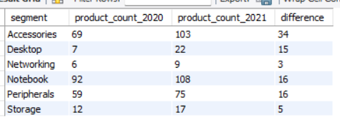
4. Follow-up: Which segment had the most increase in unique products in 2021 vs 2020? The final output contains these fields, segment product_count_2020 product_count_2021 difference
WITH
CTE1 AS (SELECT P.segment AS A ,
COUNT(DISTINCT(FS.product_code)) AS B
FROM dim_product P,
fact_sales_monthly FS
WHERE P.product_code = FS.product_code
GROUP BY FS.fiscal_year, P.segment
HAVING FS.fiscal_year = "2020"),
CTE2 AS (SELECT P.segment AS C ,
COUNT(DISTINCT(FS.product_code)) AS D
FROM dim_product P,
fact_sales_monthly FS
WHERE P.product_code = FS.product_code
GROUP BY FS.fiscal_year, P.segment
HAVING FS.fiscal_year = "2021"
)
SELECT CTE1.A AS segment,
CTE1.B AS product_count_2020,
CTE2.D AS product_count_2021,
(CTE2.D-CTE1.B) AS difference FROM CTE1,
CTE2
WHERE CTE1.A = CTE2.C ;
Insights: Accessories had the largest increase in production. Storage and networking are experiencing slower production growth than other segments.

Slide 8
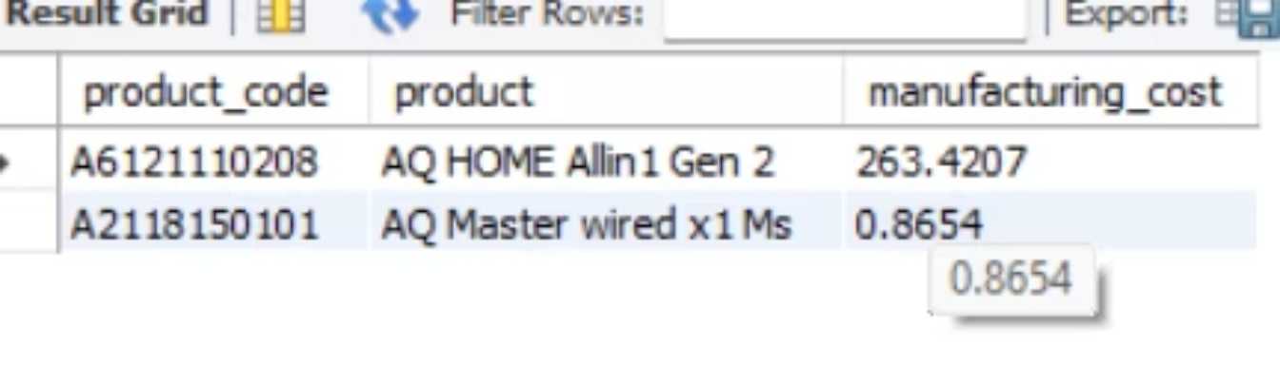
5. Get the products that have the highest and lowest manufacturing costs. The final output should contain these fields, product_code product manufacturing_cost
SELECT F.product_code,P.product,F.manufacturing_cost FROM
fact_manufacturing_cost F
JOIN
dim_product P
ON
F.product_code=P.product_code
WHERE
manufacturing_costIN (
SELECT MAX(manufacturing_cost)
FROM fact_manufacturing_cost
UNION
SELECT MIN(manufacturing_cost)
FROM fact_manufacturing_cost)
ORDER BY manufacturing_cost DESC ;
Insights: Mouse: AQ Master wired x1 Ms (Variant: Standard 1) has the lowest manufacturing cost. Personal Desktop: AQ Home Allin1 Gen2 (Variant: Plus 3) has the highest manufacturing cost

Slide 9
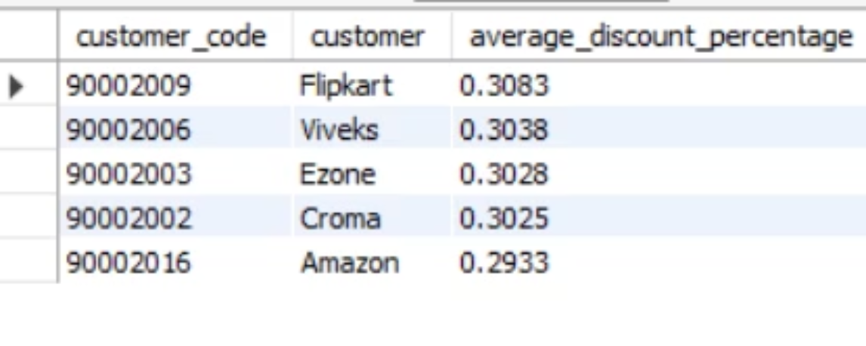
6. Generate a report which contains the top 5 customers who received an average high pre_invoice_discount_pct for the fiscal year 2021 and in the Indian market. The final output contains these fields, customer_code customer average_discount_percentage
WITH
TBL1 AS(SELECT customer_code AS A,
AVG(pre_invoice_discount_pct) AS B
FROM fact_pre_invoice_deductions
WHERE fiscal_year = '2021’
GROUP BY customer_code),
TBL2 AS(SELECT customer_code AS C,
customer AS D
FROM dim_customer
WHERE market = 'India’)
SELECT
TBL2.C AS customer_code,
TBL2.D AS customer,
ROUND (TBL1.B, 4) AS average_discount_percentage
FROM TBL1
JOIN
TBL2
ON TBL1.A = TBL2.C
ORDER BY average_discount_percentage DESCLIMIT 5
Insights: The largest average pre-invoice discount was given to Flipkart. The least average pre-invoice discount was given to Amazon

Slide 10
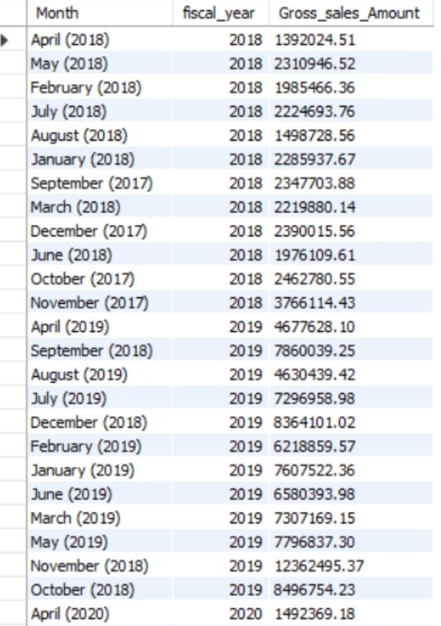
7. Get the complete report of the Gross sales amount for the customer "Atliq Exclusive" for each month. This analysis helps to get an idea of low and high-performing months and take strategic decisions. The final report contains these columns: Month Year Gross sales Amount
SELECT
CONCAT(MONTHNAME(FS.date), ' (', YEAR(FS.date), ')') AS 'Month’,
FS.fiscal_year,
ROUND(SUM(G.gross_price*FS.sold_quantity), 2) AS Gross_sales_Amount
FROM fact_sales_monthly FS
JOIN dim_customer C
ON
FS.customer_code = C.customer_code
JOIN fact_gross_price G
ON
FS.product_code = G.product_code
WHERE C.customer = 'Atliq Exclusive’
GROUP BY Month, FS.fiscal_year
ORDER BY FS.fiscal_year ;
Insights: The lowest Gross sales total for both fiscal years is in March (2020). The highest Gross sales total for both fiscal years is in November (2020). 73.8% of the total Gross sales figure is in FY 2021

Slide 11
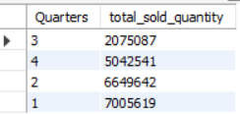
8. In which quarter of 2020, got the maximum total_sold_quantity? The final output contains these fields sorted by the total_sold_quantity, Quarter total_sold_quantity
SELECT
CASE
WHEN date BETWEEN '2019-09-01' AND '2019-11-01' then 1
WHEN date BETWEEN '2019-12-01' AND '2020-02-01' then 2
WHEN date BETWEEN '2020-03-01' AND '2020-05-01' then 3
WHEN date BETWEEN '2020-06-01' AND '2020-08-01' then 4
END AS Quarters,
SUM(sold_quantity) AS total_sold_quantity
FROM fact_sales_monthly
WHERE fiscal_year = 2020
GROUP BY Quarters
ORDER BY total_sold_quantity
Insights: Quarter 1 of FY2020 saw the most units sold overall, while Quarter 3 had the fewest. The highest and lowest overall sold quantity is in December and March. Quarter 1 accounts for approximately 34% of the total sold quantity for FY2020.

Slide 12
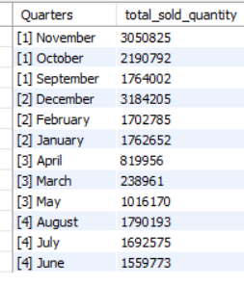
SELECT
CASE
WHEN date BETWEEN '2019-09-01' AND '2019-11-01' then CONCAT('[',1,'] ',MONTHNAME(date))
WHEN date BETWEEN '2019-12-01' AND '2020-02-01' then CONCAT('[',2,'] ',MONTHNAME(date))
WHEN date BETWEEN '2020-03-01' AND '2020-05-01' then CONCAT('[',3,'] ',MONTHNAME(date))
WHEN date BETWEEN '2020-06-01' AND '2020-08-01' then CONCAT('[',4,'] ',MONTHNAME(date))
END AS Quarters,
SUM(sold_quantity) AS total_sold_quantity
FROM fact_sales_monthly
WHERE fiscal_year = 2020
GROUP BY Quarters

Slide 13
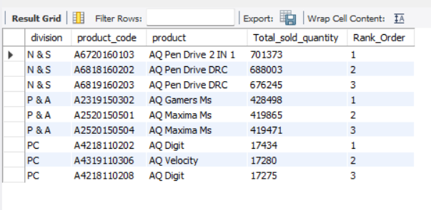
9. Get the Top 3 products in each division that have a high total_sold_quantity in the fiscal_year 2021? The final output contains these fields, division, product_code, product ,total_sold_quantity, rank_order
WITH Output1 AS
(
SELECT P.division, FS.product_code, P.product,
SUM(FS.sold_quantity) AS Total_sold_quantity
FROM dim_product P JOIN fact_sales_monthly FS
ON P.product_code = FS.product_code
WHERE FS.fiscal_year = 2021
GROUP BY FS.product_code, division, P.product
),
Output2 AS
(
SELECT division, product_code, product, Total_sold_quantity,
RANK() OVER(PARTITION BY division ORDER BY Total_sold_quantity DESC) AS 'Rank_Order’
FROM Output1
)
SELECT Output1.division, Output1.product_code, Output1.product, Output2.Total_sold_quantity, Output2.Rank_Order
FROM Output1 JOIN Output2
ON Output1.product_code = Output2.product_code
WHERE Output2.Rank_Order IN (1,2,3)

Slide 14
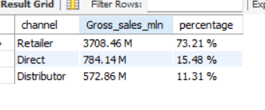
10. Which channel helped to bring more gross sales in the fiscal year 2021 and the percentage of contribution? The final output contains these fields, channel gross_sales_mln percentage
WITH Output AS
(
SELECT C.channel,
ROUND(SUM(G.gross_price*FS.sold_quantity/1000000), 2) AS Gross_sales_mln
FROM fact_sales_monthly FS JOIN dim_customer C ON FS.customer_code = C.customer_code JOIN fact_gross_price G ON FS.product_code = G.product_code
WHERE FS.fiscal_year = 2021
GROUP BY channel
)
SELECT channel,
CONCAT(Gross_sales_mln,' M') AS Gross_sales_mln ,
CONCAT(ROUND(Gross_sales_mln*100/total , 2), ' %') AS percentage
FROM
(
(SELECT SUM(Gross_sales_mln) AS total FROM Output) A,
(SELECT * FROM Output) B
)
ORDER BY percentage DESC
Insights: Channel: "Retailer" helped bring maximum sales to the company with 73.22% as the contribution percentage. Channel: "Distributor" makes the least contribution at a percentage of 11.31%

